Slide 1
Using Code Metrics for Targeted Refactoring

Slide 2

Today’s Discussion
Why do we refactor?
How do we know when to refactor?
Refactoring techniques
Refactoring in the real world

Slide 3
Why do we refactor code?
What is the goal of refactoring?
  Reduce Complexity

Slide 4
Why do we refactor code?
Why Reduce Complexity?
Increases testability
Decreases maintenance
Reducing Complexity

Slide 5
How do we traditionally know when to refactor?
“Code Smell”
  feeling = subjective

Slide 6
How do we traditionally know when to refactor?
Example Code Smells
  Comments
  Long Methods
  Long Classes

Slide 7
How can we approach refactoring objectively?
Code Metrics
  What are they?
  Why aren’t they used often?

Slide 8
Code Metrics
Cyclomatic Complexity
  Distinct paths
    conditionals, loops

Slide 9
Code Metrics: Cyclomatic Complexity
How can one determine CC?
  PMD - Java
  CCMetrics - .NET
  CCCC – C/C++

Slide 10
Code Metrics: Cyclomatic Complexity
Rules of Thumb:
  methods > 10 = complex
  excellent coverage:
    1:1 ratio of test cases to cc

Slide 11
Code Metrics: Cyclomatic Complexity
False Positives
  “update” logic
  ignore aggregates

Slide 12
Code Metrics
Depth of Inheritance
  “If you use inheritance where composition will work, your designs will become needlessly complicated.”
  –Bruce Eckel, Thinking In Java

Slide 13
Code Metrics: Depth of Inheritance
How can one determine DIT?
  Eclipse Metrics plug-in - Java
  NDepend - .NET
  CCCC – C/C++

Slide 14
Code Metrics: Depth of Inheritance
Rule of Thumb
  excessive depths:
    increase difficulty in testing
    decrease comprehensibility

Slide 15
Code Metrics: Depth of Inheritance
False Positives
  Exception Hierarchies & GUI frameworks usually have high DIT

Slide 16
Code Metrics
Non Commenting LOC
  Method Length
  Class Length

Slide 17
Code Metrics: Method Length
Method Length
  100+ NCLOC
    too much work
    increased complexity

Slide 18
Code Metrics: Class Length
Class Length
  1000+ NCLOC
    too much responsibility
    complex

Slide 19
Code Metrics: Class Length
Public Method Count
  Many = lots of responsibility
    difficult to test

Slide 20
Code Metrics: Class Length
Unique Attributes
  45+ unique types (think imports)
    Members, parameters, variables
      brittle

Slide 21
Code Metrics: Lines of Code
How to determine high LOC?
  JavaNCSS - Java
  NDepend - .NET
  CCCC – C/C++

Slide 22
Code Metrics: Lines of Code
Rules of Thumb
  High LOCs
    complexity
    difficulty in testing
    brittleness

Slide 23
Code Metrics: Lines of Code
False Positives
  Facades, Transfer Objects, POJOs, etc
    many public methods
      LOC is high

Slide 24
Code Metrics
Rules of Thumb
  Code metrics are objective
    Application subjective
  High LOC != Productivity

Slide 25
Code Metrics
Common Correlations
Long Methods
High CC

Slide 26
Code Metrics
Many Imports
Many Unique
Types
High CC
Long Class
Long Methods

Slide 27
Refactoring Techniques
Books
    Refactoring: Improving the Design of Existing Code
    Refactoring to Patterns
    Working Effectively with Legacy Code
Website
    http://www.refactoring.com/catalog/index.html

Slide 28
Refactoring Techniques
Long Methods
  Extract Method
  Substitute Algorithm
  Add Parameter

Slide 29

Refactoring Techniques
Add Parameter

Slide 30
Refactoring Techniques
Long Classes
  Extract Class
  Extract Subclass
    Push Down Method
    Form Template Pattern

Slide 31
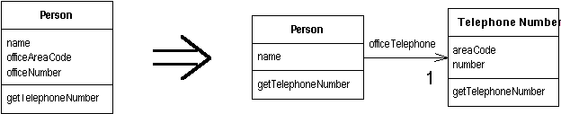
Refactoring Techniques
Extract Class

Slide 32
Refactoring Techniques
Depth of Inheritance
  Replace Inheritance with Delegation
  Pull up and Push down Method

Slide 33
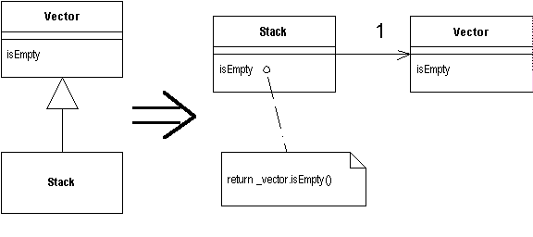
Refactoring Techniques
Replace Inheritance with Delegation

Slide 34
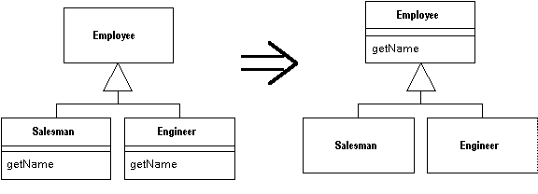
Refactoring Techniques
Pull up Method

Slide 35
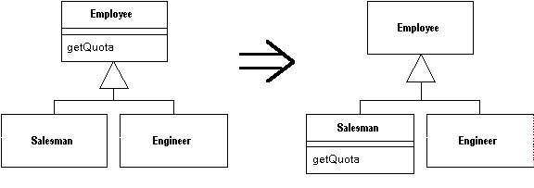
Refactoring Techniques
Push Down Method

Slide 36
Refactoring Techniques
Too Many Imports
  Extract Class

Slide 37
Refactoring Techniques
Cyclomatic Complexity
  Replace Conditional with Polymorphism
  Extract Method

Slide 38
Refactoring Techniques
Refactoring demo
  Extract Method
  Testing the refactoring
  http://www.testearly.com/2006/09/11/extract-method-refactoring-movie/

Slide 39
Refactoring for Real
Find Complexity
  Run PMD
    visual confirms maintenance issue

Slide 40
Refactoring for Real
Conditionals
  Keep growing
  Affect testability

Slide 41
Refactoring for Real
Solution
  Replace Conditionals with Polymorphism
  Extract Class
  Liberal interpretation of GOF patterns

Slide 42
Refactoring for Real
GOF Patterns
  Abstract Factory
  Chain of Responsibility
  Strategy

Slide 43
Refactoring for Real
Benefits?
  Plug-ability
  Testability
    pushed complexity into manageable pieces

Slide 44
Resources
Check out: www.testearly.com
My blog: www.thediscoblog.com
Code Quality series on devWorks: www.thediscoblog.com/publications

Slide 45
Review of Today’s Discussion
Why do we refactor?
How do we know when to refactor?
Refactoring techniques
Refactoring in the real world

Slide 46
Using Metrics For Targeted Refactoring
Thank you!
  Questions? Comments?
Please Contact:
Andrew Glover
aglover@stelligent.com
www.thediscoblog.com
www.testearly.com

